Slide 1

Modelling Anthropogenic Climate Change
By Thomas Davies
Supervised by: Craig P. Testrow & Richard J. Wilman
Department of Physics, Durham University

Slide 2
Table of contents page.

Slide 3
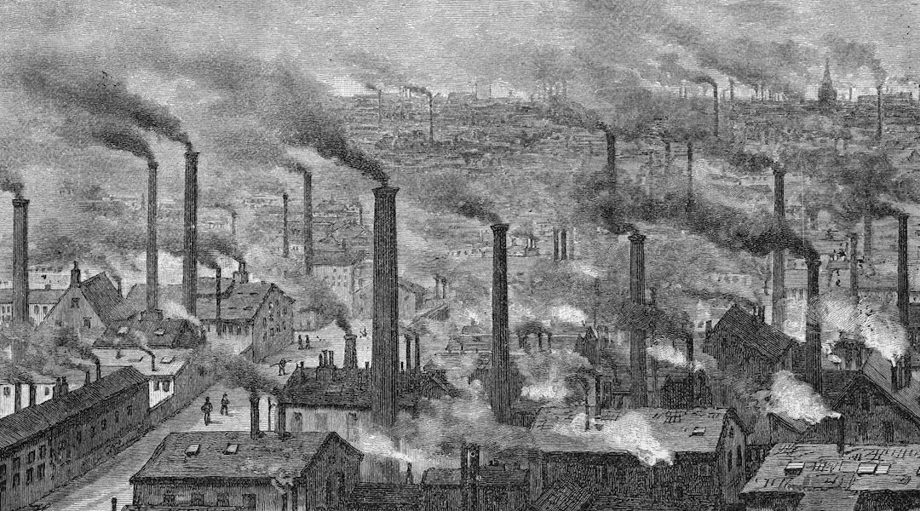
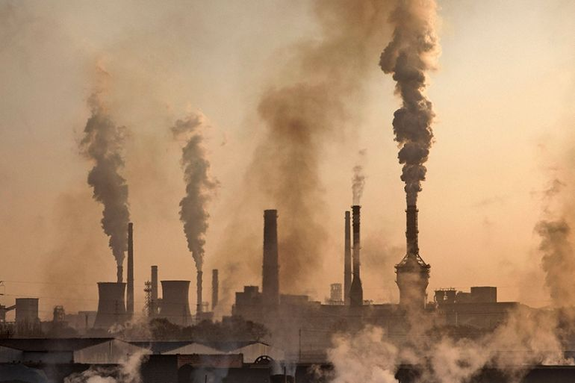
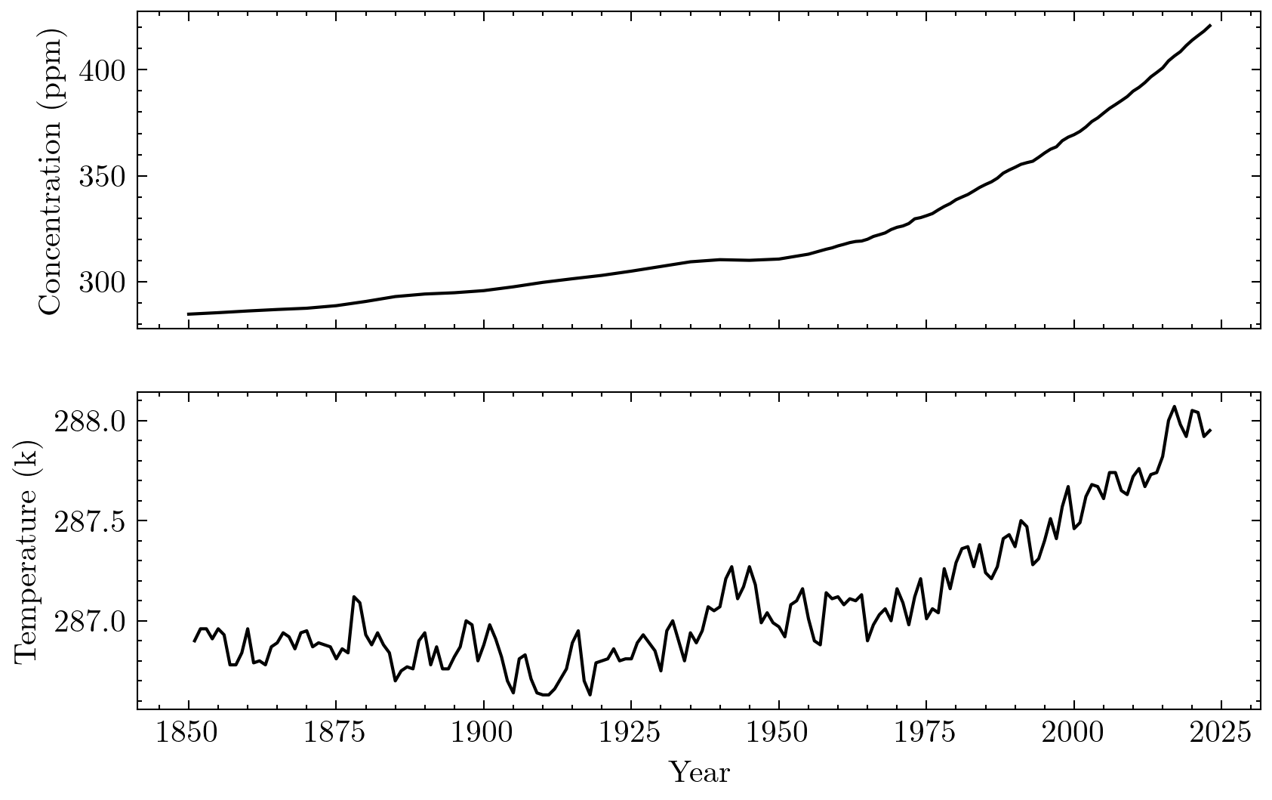
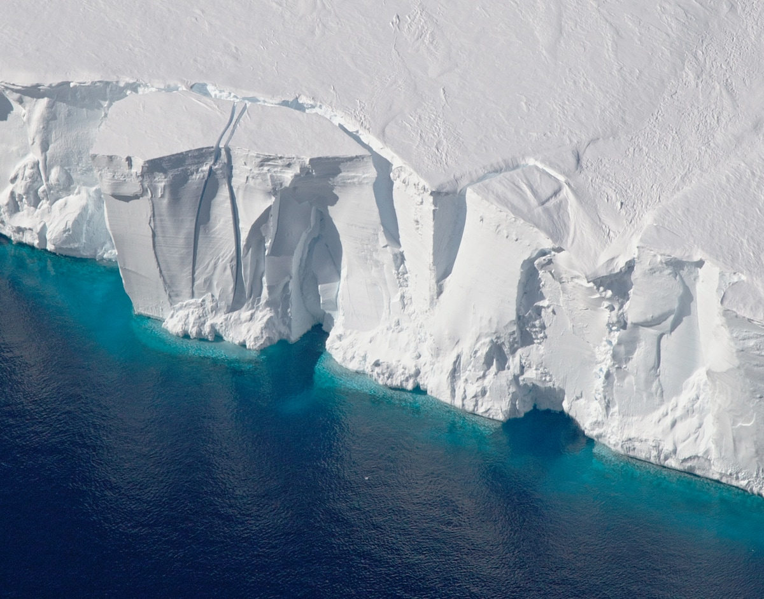

Atmospheric CO2 levels
Why is atmospheric CO2 increasing?
How does this effect global temperature?

Slide 4
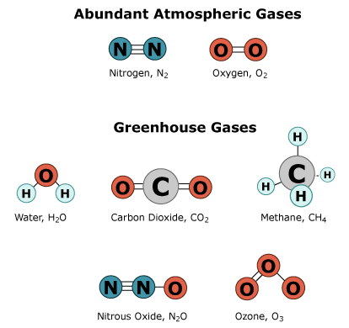
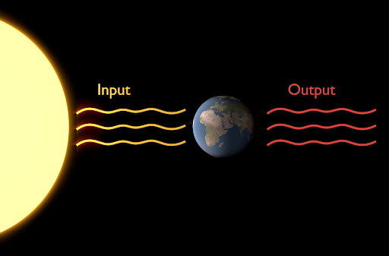
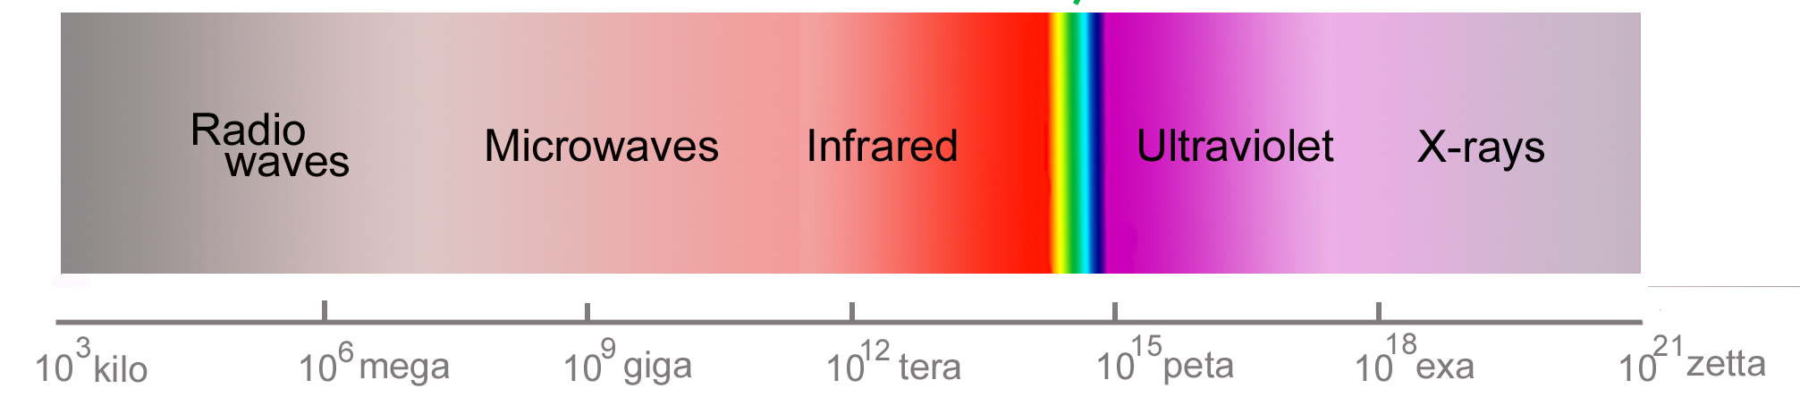
The Greenhouse effect
What is a greenhouse gas?
How do they effect global temperature?

Slide 5
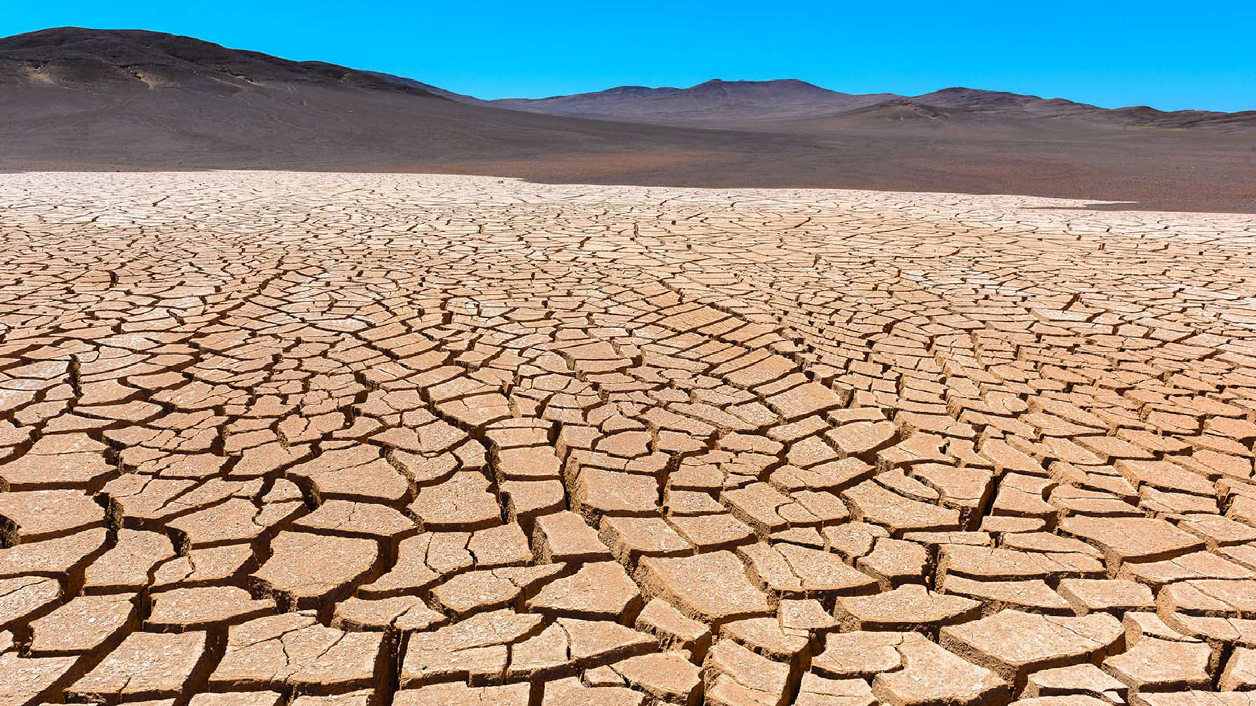
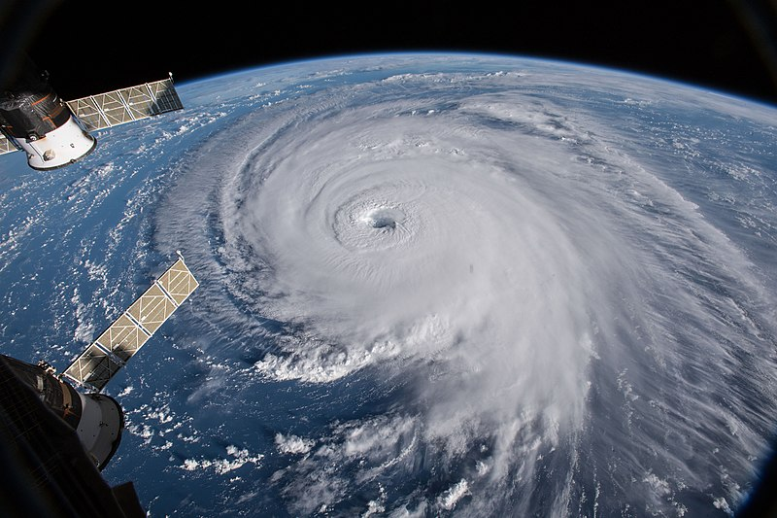
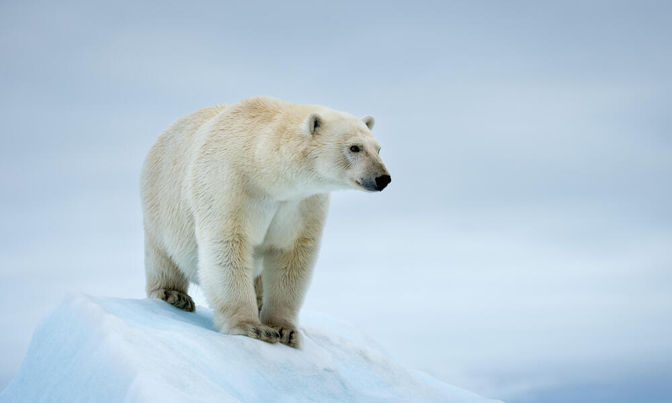
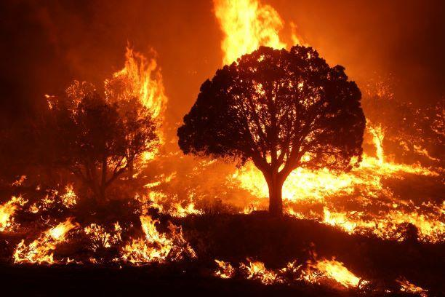
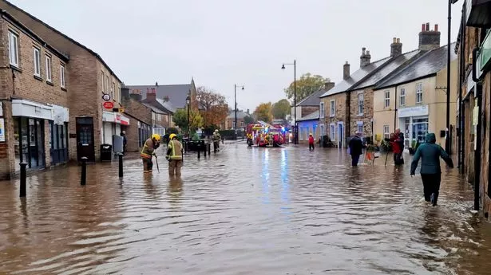
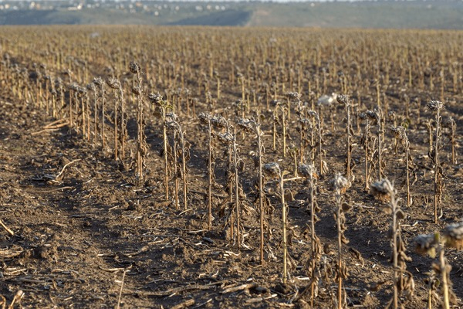
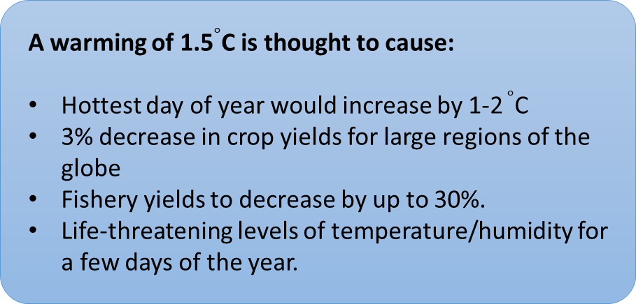
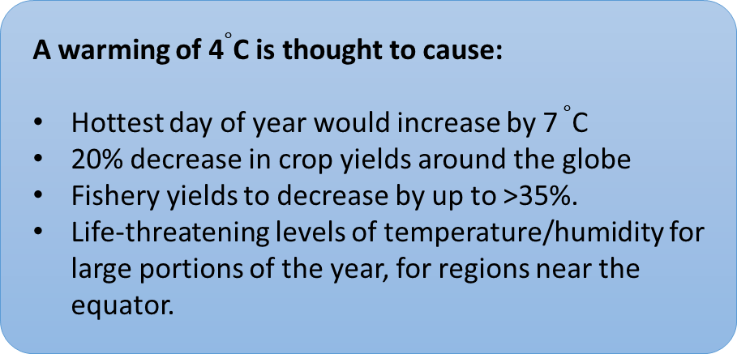
Consequences of a warming climate
A warming of 1.5$∘$C is thought to cause:
Hottest day of year would increase by 1-2 $∘$C
3% decrease in crop yields for large regions of the globe
Fishery yields to decrease by up to 30%.
Life-threatening levels of temperature/humidity for a few days of the year.
A warming of 4$∘$C is thought to cause:
Hottest day of year would increase by 7 $∘$C
20% decrease in crop yields around the globe
Fishery yields to decrease by up to >35%.
Life-threatening levels of temperature/humidity for large portions of the year, for regions near the equator.

Slide 6
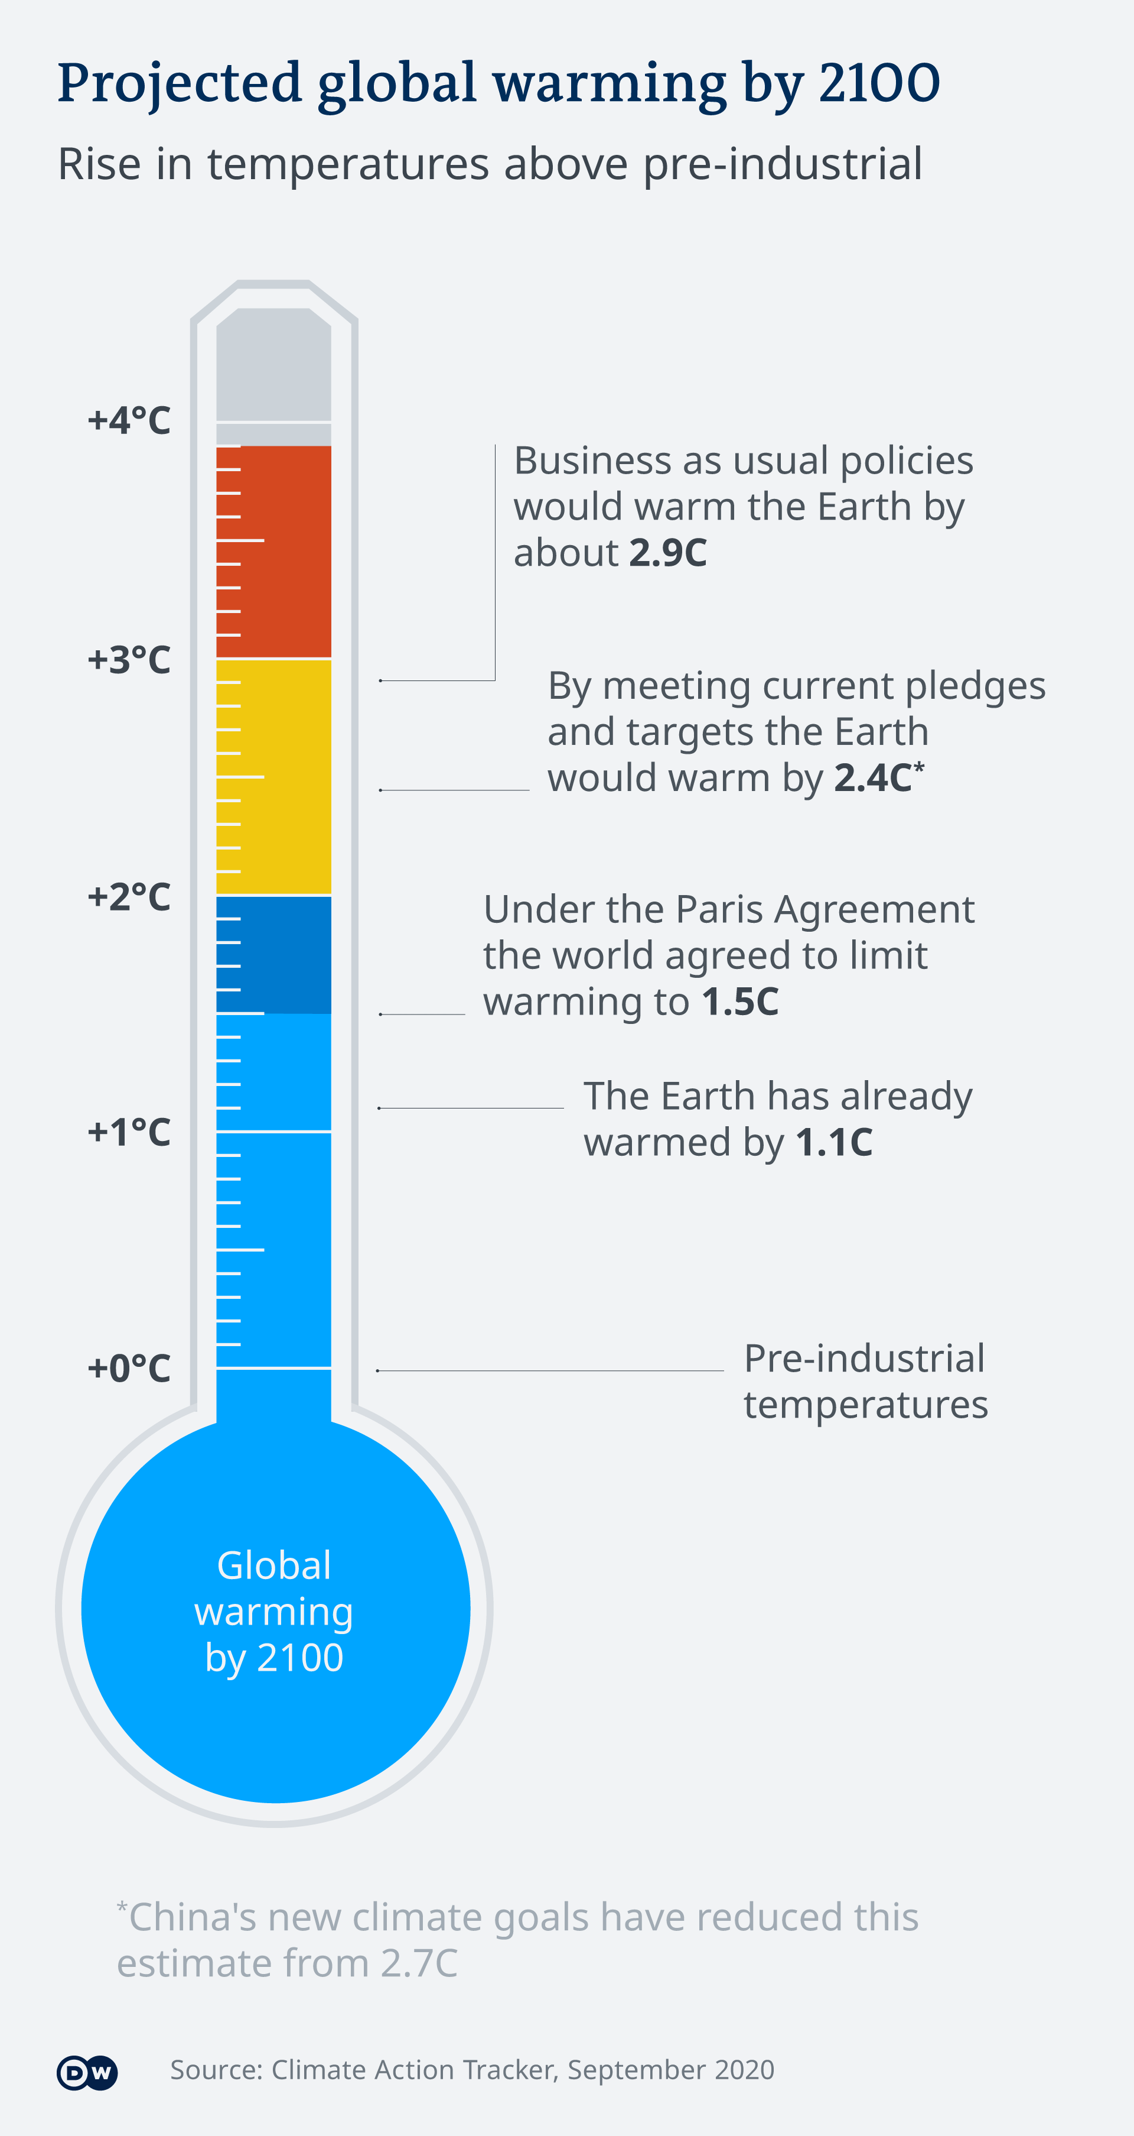
Project Aims
The Paris agreement
The next contender?
Consequences of this (wildfires, drought frequency)

Slide 7
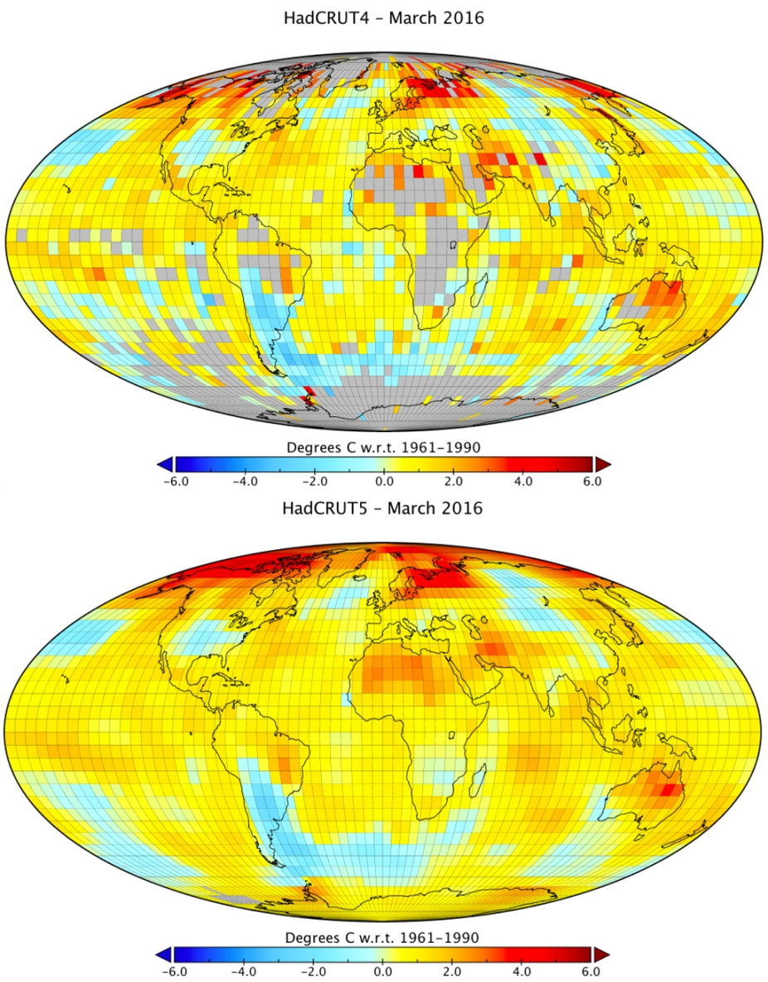
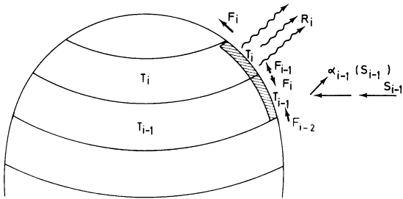
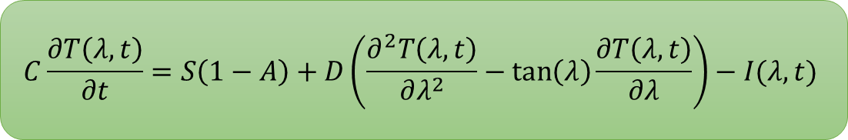
Climate Model
One-Dimensional Climate Model | (1D EBM)
$$C\frac{∂T\left(λ, t\right)}{∂t}=S\left(1−A\right)+D\left(\frac{∂^{2}T\left(λ, t\right)}{∂λ^{2}}−\tan\left(λ\right)\frac{∂T\left(λ, t\right)}{∂λ}\right)−I(λ,t)$$

Slide 9
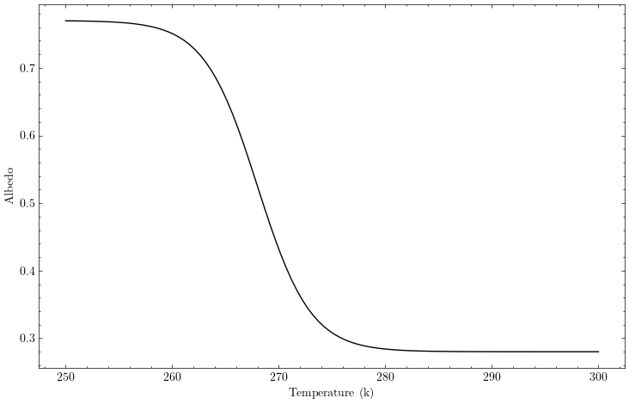
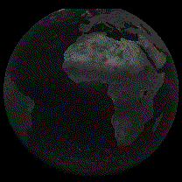
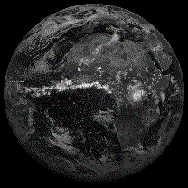
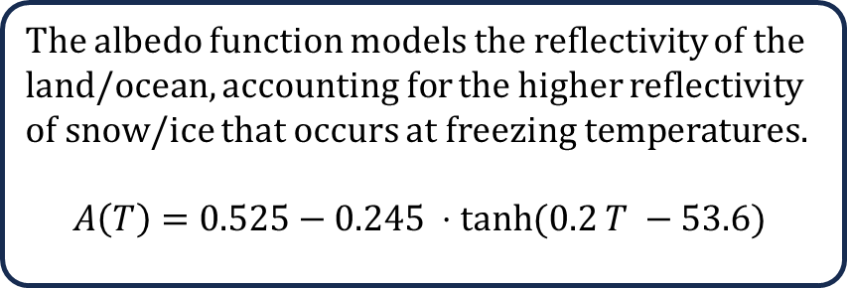
Albedo Function
The albedo function models the reflectivity of the land/ocean, accounting for the higher reflectivity of snow/ice that occurs at freezing temperatures.
$$A\left(T\right)=0.525−0.245 ⋅tanh⁡(0.2 T −53.6)$$
A(Ice) = 0.7 (high reflectance)
A(land/ocean) = 0.3 (low reflectance)
Future Work: Possible work could be done to include the effect that atmospheric cloud cover has on the albedo of a latitude band

Slide 10
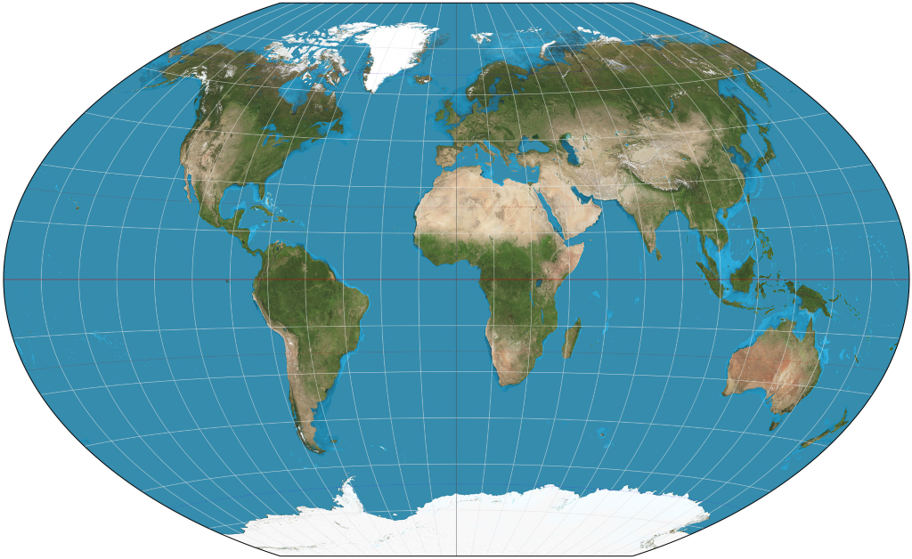
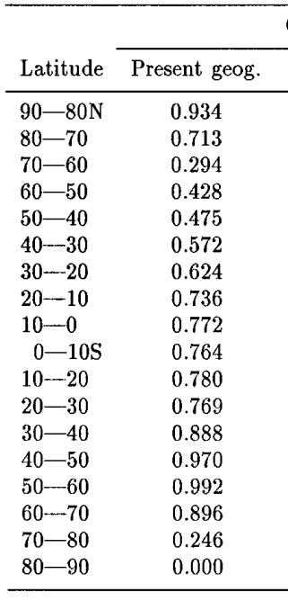
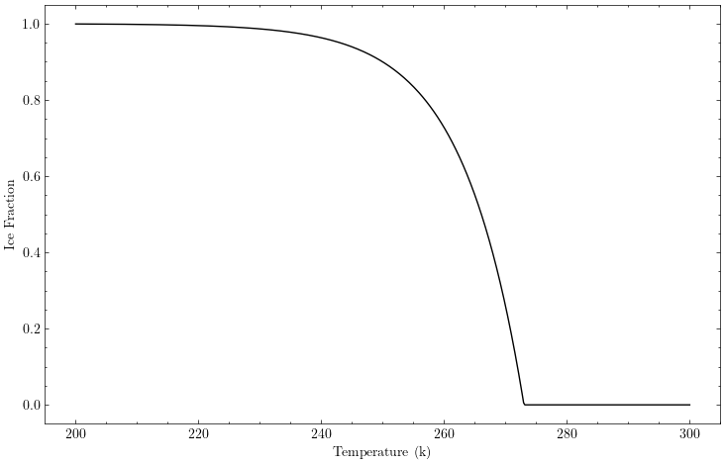
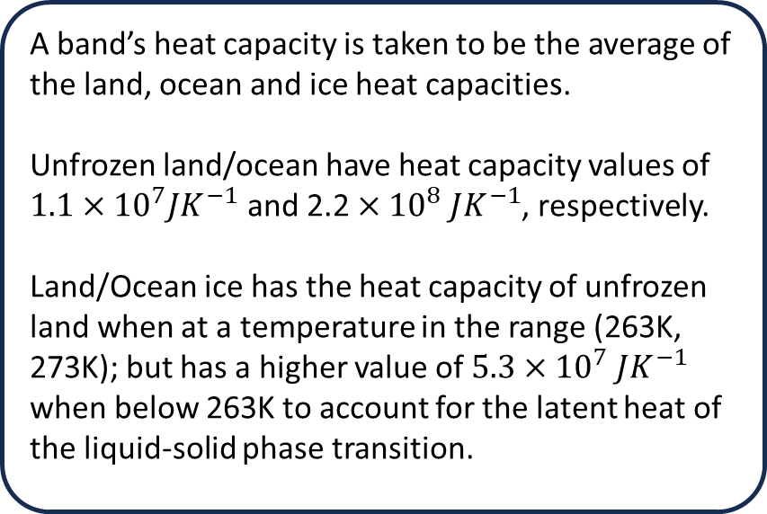
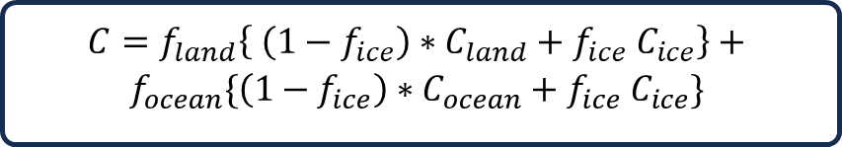
1D EBM | Heat Capacity Model
The Heat capacity (C) of a latitude band, tells us how much thermal energy is required for the band’s temperature to change by 1 degree Kelvin.
$$C=f_{land}\left\{ \left(1−f_{ice}\right)∗C_{land}+f_{ice}{ C}_{ice}\right\}+$$
$$f_{ocean}\{\left(1−f_{ice}\right)∗C_{ocean}+f_{ice} C_{ice}\}$$
A band’s heat capacity is taken to be the average of the land, ocean and ice heat capacities.
Unfrozen land/ocean have heat capacity values of $1.1×{10}^{7}JK^{−1}$ and $\text{2.2}×{10}^{8} JK^{−1}$, respectively.
Land/Ocean ice has the heat capacity of unfrozen land when at a temperature in the range (263K, 273K); but has a higher value of $5.3×{10}^{7} JK^{−1}$ when below 263K to account for the latent heat of the liquid-solid phase transition.

Slide 11
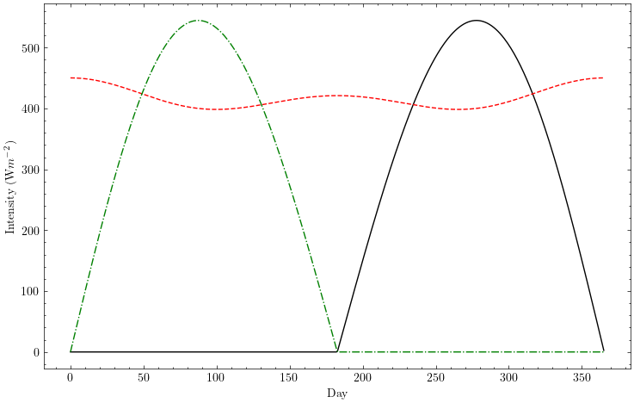
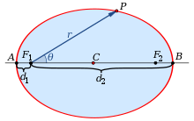
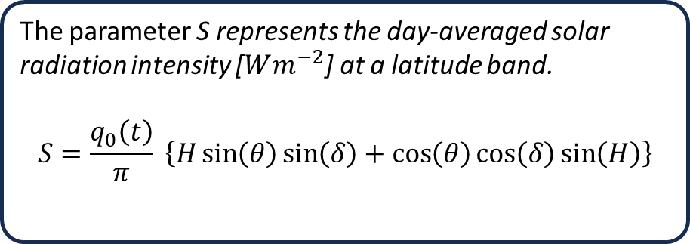
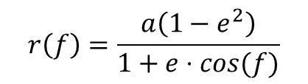
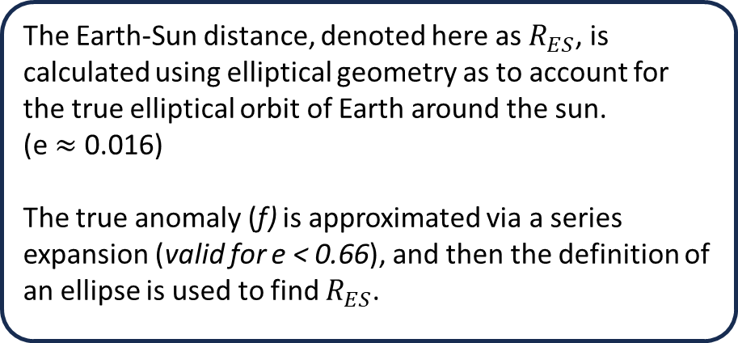
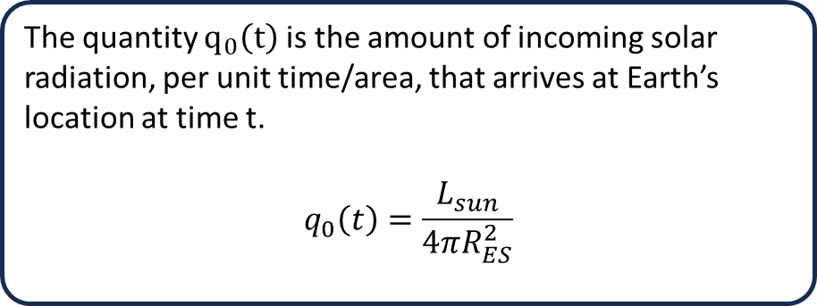
1D EBM | Solar Radiation
The parameter S represents the day-averaged solar radiation intensity [$Wm^{−2}$] at a latitude band.
$$S=\frac{q_{0}\left(t\right)}{π} \left\{H\sin\left(θ\right)\sin\left(δ\right)+\cos\left(θ\right)\cos\left(δ\right)\sin\left(H\right)\right\}$$
The Earth-Sun distance, denoted here as $R_{ES}$, is calculated using elliptical geometry as to account for the true elliptical orbit of Earth around the sun.
(e $≈$ 0.016)
The true anomaly (f) is approximated via a series expansion (valid for e < 0.66), and then the definition of an ellipse is used to find $R_{ES}$.
The quantity $q_{0}\left(t\right)$ is the amount of incoming solar radiation, per unit time/area, that arrives at Earth’s location at time t.
$$q_{0}\left(t\right)=\frac{L_{sun}}{4πR_{ES}^{2}}$$
$$r\left(f\right)=\frac{a\left(1−e^{2}\right)}{1+e⋅cos(f)}$$

Slide 12
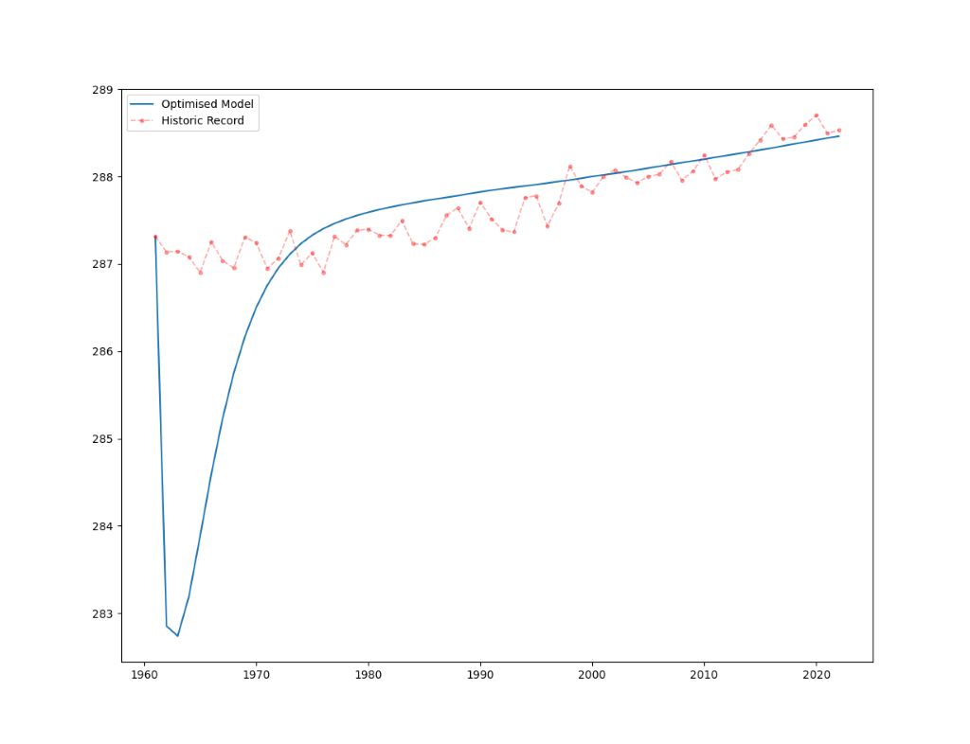
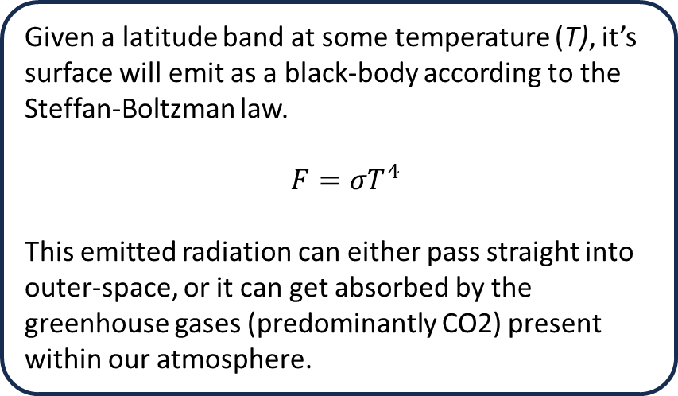
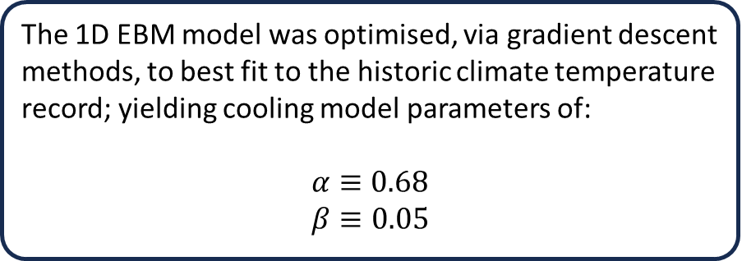
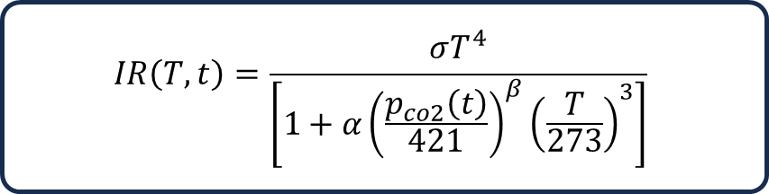
1D EBM | Infrared Cooling Model
The IR Cooling model describes the amount of (IR) radiation, emitted by Earth’s surface, that escapes into outer-space.
The 1D EBM model was optimised, via gradient descent methods, to best fit to the historic climate temperature record; yielding cooling model parameters of:
$$α≡0.68$$
$$β≡0.05$$
Given a latitude band at some temperature (T), it’s surface will emit as a black-body according to the Steffan-Boltzman law.
$F=σT^{4}$
This emitted radiation can either pass straight into outer-space, or it can get absorbed by the greenhouse gases (predominantly CO2) present within our atmosphere.
$$IR\left(T, t\right)=\frac{σT^{4}}{\left[1+α{\left(\frac{p_{co2}\left(t\right)}{421}\right)}^{β}{\left(\frac{T}{273}\right)}^{3}\right]}$$

